Slide 1
Biometric Data Viewer
By Andrew McKernan

Slide 2
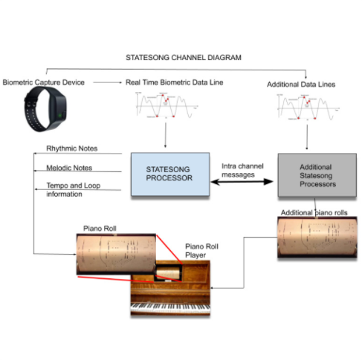
StateSong Model
Transform biometric data into music for deeper meditation.
Allow users to customize and create their own presets for generating music.

Slide 3
Difficulties Working with Real Time Data
Tens of thousands of rows
Different sampling rates
Hard to visualize Accelerometer data

Slide 4
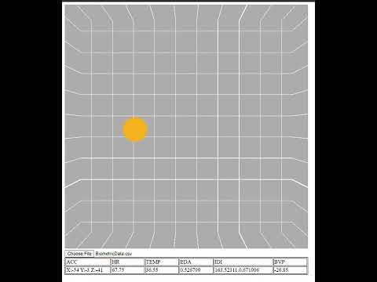
Solution: Biometric Data Viewer

